Slide 1
Structure Programming
ICT-1105
Information and Communication Technology
Lecture-20
Date:

Slide 2
Class contents has given in Google Classroom with code
nhauiw4

Slide 3
Structures and Unions

Slide 4
Structures

Slide 5
Structure Definition
Structure is a user defined data type which hold or store heterogeneous/different types data item or element in a single variable. It is a Combination of primitive and derived data type.
Or
A structure is a collection of one or more data items of different data types, grouped together under a single name.
Variables inside the structure are called members of structure.
Each element of a structure is called a member.

Slide 6
Structure Definition
The variable within a structure are of different data types and each has a name that is used to select it from the structure.
C arrays allow you to define type of variables that can hold several data items of the same kind but structure is another user defined data type available in C programming, which allows you to combine data items of different kinds.

Slide 7
Structure Definition
Structures are used to represent a record, Suppose you want to keep track of your books in a library. You might want to track the following attributes about each book:
• Title
• Author
• Subject
• Book ID

Slide 8
Structure Definition
struct keyword is used to define/create a structure.
struct define a new data type which is a collection of different type of data

Slide 9
Structure Declaration
Syntax:
struct structure_name /tag name
{
data_type member1;
data_type member2;
.
.
data_type member n;
};
Note: Don't forget the semicolon }; in the ending line.

Slide 10
Structure Declaration
Example
struct employee
{
int id;
char name[50];
float salary;
};

Slide 11
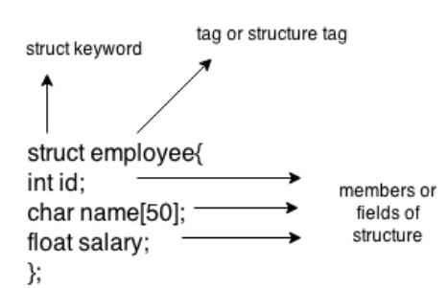
Structure Declaration
Here, struct is the keyword, employee is the tag name of structure; id, name and salary are the members or fields of the structure. Let's understand it by the diagram given below:

Slide 12
Structure variable
Syntax to create structure variable
struct tagname/structure_name variable;

Slide 13
Structure variable
Declaring structure variable:
We can declare variable for the structure, so that we can access the member of structure easily. There are two ways to declare structure variable:
1. By struct keyword within main() function/ Declaring Structure variables separately
2. By declaring variable at the time of defining structure/ Declaring Structure Variables with Structure definition

Slide 14
Structure variable
1st way:
Let's see the example to declare structure variable by struct keyword. It should be declared
within the main function.
struct employee
{ int id;
char name[50];
float salary;
};
Now write given code inside the main() function.
struct employee e1, e2;

Slide 15
Structure variable
2nd way:
Let's see another way to declare variable at the time of defining structure.
struct employee
{
int id;
char name[50];
float salary;
} e1,e2;

Slide 16
Structure variable
Which approach is good?
If no. of variable are not fixed, use 1st approach. It provides you flexibility to declare the structure variable many times.
If no. of variables are fixed, use 2nd approach. It saves your code to declare variable in main() function.

Slide 17
Structure Initialization
Assigning constants to the members of the structure is called initializing of structure.
Syntax:
struct struct_name
{
data _type member_name1;
data _type member_name2;
} struct struct_name var={constant1,constant2};

Slide 18
Structure Initialization
Example:
struct Patient
{
float height;
int weight;
int age;
};
struct Patient p1 = { 180.75 , 73, 23 }; //initialization

Slide 19
Structure Initialization
Example:
or
struct Patient p1;
p1.height = 180.75; //initialization of each member separately
p1.weight = 73;
p1.age = 23;

Slide 20
Accessing Structures/ Accessing members of structure
There are two ways to access structure members:
1. By . (member or dot operator)
2. By -> (structure pointer operator)
When the variable is normal type then go for struct to member operator.
When the variable is pointer type then go for pointer to member operator.

Slide 21
Accessing Structures/ Accessing members of structure
Any member of a structure can be accessed as:
structure_variable_name.member_name
Example
struct book
{
char name[20];
char author[20];
int pages;
}; struct book b1;
for accessing the structure members from the above example
b1.name, b1.author, b1.pages:

Slide 22
Accessing Structures/ Accessing members of structure
Data members of the structure variable stud, we write,
stud.roll=01;
stud.name=”Rahul”;
To input values for data members of the structure variable stud, can be written as,
scanf(“%d”,&stud.roll);
scanf(‘’%s”,&stud.name);
To print the values of structure variable stud, can be written as:
printf(“%d”,stud.roll);
printf(“%s”,stud.name);

Slide 23
Accessing Structures/ Accessing members of structure
Example:
struct emp
{
int id;
char name[36];
int sal;
};
sizeof(struct emp) // --> 40 byte (2byte+36byte+2byte)

Slide 24
Structure in C
Example 01:
#include<stdio.h>
#include<conio.h>
struct emp
{
int id;
char name[36];
float sal;
};
void main()
{
struct emp e;
clrscr();
printf("Enter employee Id, Name, Salary: ");
scanf("%d",&e.id);
scanf("%s",&e.name);
scanf("%f",&e.sal);
printf("Id: %d",e.id);
printf("\nName: %s",e.name);
printf("\nSalary: %f",e.sal);
getch();
}

Slide 25
Structure in C
Example 02:
#include <stdio.h>
#include <string.h>
struct employee
{ int id;
char name[50];
}e1; //declaring e1 variable for structure
int main( )
{
//store first employee information
e1.id=101;
strcpy(e1.name, “Abdul Karim");//copying string into char array
//printing first employee information
printf( "employee 1 id : %d\n", e1.id);
printf( "employee 1 name : %s\n", e1.name);
return 0;
}

Slide 26
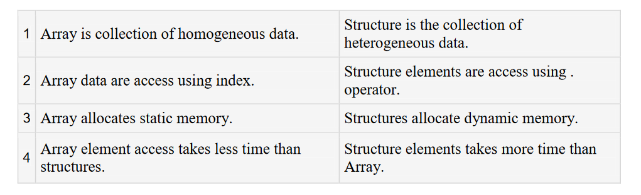
Difference Between Array and Structure

Slide 27
Nested Structures
The structure that contains another structure as its members is called a nested structure.
or
A structure within a structure is called nested structure.
The structure should be declared separately and then be grouped into high level structure.

Slide 28
Nested Structures
There are two ways to define nested structure
in c language:
1. By separate structure
2. By Embedded structure

Slide 29
Separate structure
We can create 2 structures, but dependent structure should be used inside the main structure as a member. Let's see the code of nested structure.

Slide 30
Separate structure
struct Date
{
int dd;
int mm;
int yyyy;
};
struct Employee
{
int id;
char name[20];
struct Date doj;
}emp1;

Slide 31
Embedded structure
struct Employee
{
int id;
char name[20];
struct Date
{
int dd;
int mm;
int yyyy;
}doj;
}emp1;

Slide 32
Accessing Nested Structure
We can access the member of nested structure by Outer_Structure.Nested_Structure.member as
given below:
e1.doj.dd
e1.doj.mm
e1.doj.yyyy

Slide 33
Arrays of Structures
Array of structures to store much information of different data types. Each element of the array
representing a structure variable.
The array of structures is also known as collection of structures.

Slide 34
Arrays of Structures
Ex : if you want to handle more records within one structure, we need not specify the number of structure variable. Simply we can use array of structure variable to store them in one structure
variable.
Example : struct employee emp[5];

Slide 35
Arrays of Structures
Example of structure with array that stores information of 5 students and prints it.
#include<stdio.h>
#include<conio.h>
#include<string.h>
struct student{
int rollno;
char name[10];
};
void main(){
int i;
struct student st[5];
clrscr();

Slide 36
Arrays of Structures
printf("Enter Records of 5 students");
for(i=0;i<5;i++)
{
printf("\nEnter Rollno:");
scanf("%d",&st[i].rollno);
printf("\nEnter Name:");
scanf("%s",&st[i].name);
}
printf("\nStudent Information List:");
for(i=0;i<5;i++)
{
printf("\nRollno:%d, Name:%s",st[i].rollno,st[i].name);
}
getch();
}

Slide 37
Structures and Functions
A structure can be passed as a function argument just like any other variable. This raises a few practical issues.
PASSING STRUCTURE TO FUNCTION IN C:
It can be done in below 3 ways.
1. Passing structure to a function by value
2. Passing structure to a function by address(reference)
3. No need to pass a structure – Declare structure variable as global

Slide 38
Structures and Functions
The general format of sending a copy of a structure to the called function is:
Function_name(structure_variable_name);
The called function takes the following form:
data_type function_name(struct tag_name var)
{
----------
----------
return(exp);
}

Slide 39
Passing structure to function by value
#include <stdio.h>
#include <string.h>
struct student
{
int id;
char name[20];
float percentage;
};

Slide 40
Passing structure to function by value
void func(struct student record);
int main()
{
struct student record;
record.id=1;
strcpy(record.name, "Raju");
record.percentage = 86.5;
func(record);
return 0;
}

Slide 41
Passing structure to function by value
void func(struct student record)
{
printf(" Id is: %d \n", record.id);
printf(" Name is: %s \n", record.name);
printf(" Percentage is: %f \n", record.percentage);
}

Slide 42
Passing structure to function by reference
#include <stdio.h>
#include <string.h>
struct student
{
int id;
char name[20];
float percentage;
};

Slide 43
Passing structure to function by reference
void func(struct student *record);
int main()
{
struct student record;
record.id=1;
strcpy(record.name, "Raju");
record.percentage = 86.5;
func(&record);
return 0;
}

Slide 44
Passing structure to function by reference
void func(struct student *record)
{
printf(" Id is: %d \n", record->id);
printf(" Name is: %s \n", record->name);
printf(" Percentage is: %f \n", record->percentage);
}

Slide 45
Declare a structure variable as global
#include <stdio.h>
#include <string.h>
struct student
{
int id;
char name[20];
float percentage;
};
struct student record; // Global declaration of structure
void structure_demo();

Slide 46
Declare a structure variable as global
int main()
{
record.id=1;
strcpy(record.name, "Raju");
record.percentage = 86.5;
structure_demo();
return 0;
}

Slide 47
Declare a structure variable as global
void structure_demo()
{
printf(" Id is: %d \n", record.id);
printf(" Name is: %s \n", record.name);
printf(" Percentage is: %f \n", record.percentage);
}

Slide 48
Passing a copy of entire structure to a function
struct std
{
int no;
float avg;
};
struct std a;
void fun(struct std p);

Slide 49
Passing a copy of entire structure to a function
void main()
{
clrscr();
a.no=12;
a.avg=13.76;
fun(a);
getch();
}
void fun(struct std p)
{
printf("number is%d\n",p.no);
printf("average is%f\n",p.avg);
}

Slide 50
Passing Structures through Pointers
#include <stdio.h>
#include <string.h>
struct student
{
int id;
char name[30];
float percentage;
};

Slide 51
Passing Structures through Pointers
int main()
{
int i;
struct student record1 = {1, "Raju", 90.5};
struct student *ptr;
ptr = &record1;
printf("Records of STUDENT1: \n");
printf(" Id is: %d \n", ptr->id);
printf(" Name is: %s \n", ptr->name);
printf(" Percentage is: %f \n\n", ptr->percentage);
return 0;
}

Slide 52
Passing Structures through Pointers
OUTPUT:
Records of STUDENT1:
Id is: 1
Name is: Raju
Percentage is: 90.500000

Slide 53
Self‐referential Structures
Self –referential structures are those structures that contain a reference to data of its same type as that of structure.
A linked list is supposed to be a self-referential data structure. The next node of a node is being pointed, which is of the same struct type.

Slide 54
Self‐referential Structures
Syntax : struct tag_name
{
type member1;
type membere2;
: :
: :
typeN memberN;
struct tag_name *name;
} ;
Where *name refers to the name of a pointer variable.

Slide 55
Unions

Slide 56
Unions
A union is a special data type available in C that allows to store different data types in the same
memory location.
You can define a union with many members, but only one member can contain a value at any given time. Unions provide an efficient way of using the same memory location for multi-purpose.

Slide 57
Unions
Unions are conceptually similar to structures. The syntax of union is also similar to that of structure.
The only difference is in terms of storage.
In structure each member has its own storage location, whereas all members of union use a single shared memory location which is equal to the size of its largest data member.

Slide 58
Unions
We can access only one member of union at a time. We can’t access all member values at the same time in union. But, structure can access all member values at the same time. This is because, Union allocates one common storage space for all its members. Where as Structure allocates storage space for all its members separately.

Slide 59
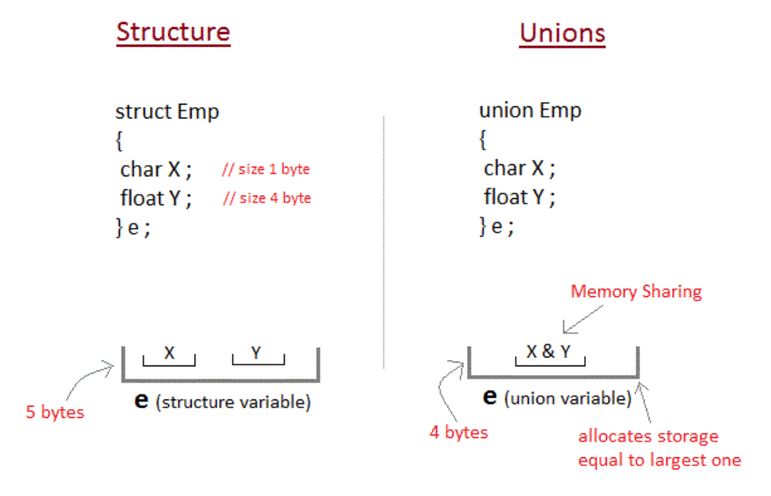
Unions

Slide 60
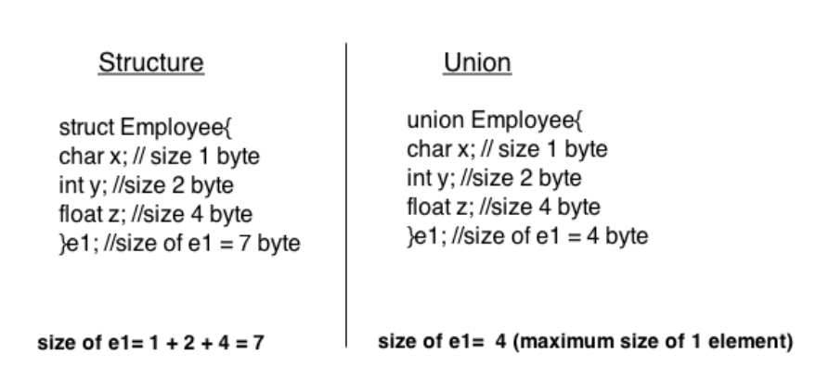
Unions

Slide 61
Unions
union union-name
{
data_type var-name;
data_type var-name;
};

Slide 62
Unions
The union tag is optional and each member definition is a normal variable definition, such as int i; or float f; or any other valid variable definition. At the end of the union's definition, before the final semicolon, you can specify one or more union variables but it is optional. Here is the way you would define a union type named Data which has the three members i, f, and str. Now, a variable of Data type can store an integer, a floating-point number, or a string of characters. This means that a single variable ie. same memory location can be used to store multiple types of data. You can use any built-in or user defined data types inside a union based on your requirement

Slide 63
Unions
The memory occupied by a union will be large enough to hold the largest member of the union. For example, in above example Data type will occupy 20 bytes of memory space because this is the maximum space which can be occupied by character string. Following is the example which will display total memory size occupied by the above union:

Slide 64
Unions
Accessing a Member of a Union
#include <stdio.h>
#include <string.h>
union Data
{
int i;
float f;
char str[20];
};
int main( )
{
union Data data;
data.i = 10;
data.f = 220.5;
strcpy( data.str, "C Programming");
printf( "data.i : %d\n", data.i);
printf( "data.f : %f\n", data.f);
printf( "data.str : %s\n", data.str);
return 0;
}

Slide 65
Unions
Dot operator can be used to access a member of the union . he member access operator is coded as a period between the union variable name and the union member that we wish to access. You would use union keyword to define variables of union type. Following is the example to explain
usage of union:

Slide 66
Unions
Example
union employee
{ int id;
char name[50];
float salary;
};

Slide 67
Unions
#include <stdio.h>
#include <string.h>
union employee
{ int id;
char name[50];
}e1; //declaring e1 variable for union

Slide 68
Unions
int main( )
{
//store first employee information
e1.id=101;
strcpy(e1.name, “Abdul Karim");//copying string into char array
//printing first employee information
printf( "employee 1 id : %d\n", e1.id);
printf( "employee 1 name : %s\n", e1.name);
return 0;
}

Slide 69
Unions
#include <stdio.h>
#include <conio.h>
union item
{
int a;
float b;
char ch;
};

Slide 70
Unions
int main( )
{
union item it;
it.a = 12;
it.b = 20.2;
it.ch='z';
clrscr();
printf("%d\n",it.a);
printf("%f\n",it.b);
printf("%c\n",it.ch);
getch();
return 0;
}

Slide 71
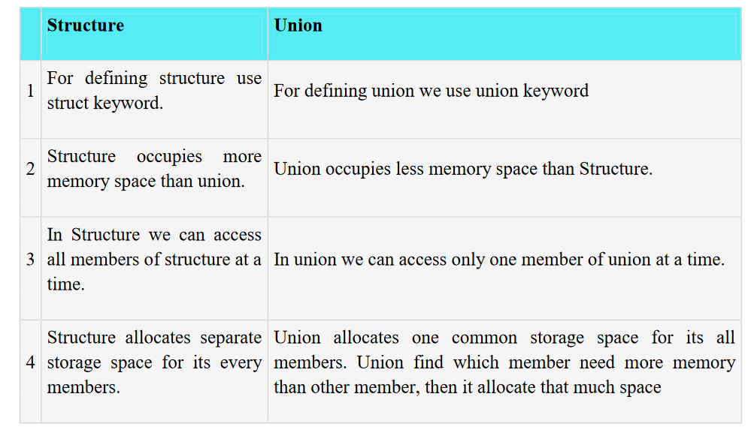
Difference between Structure and Union

Slide 72
File

Slide 73
File
A File is a collection of data stored on a secondary storage device like hard disk. File operation is to combine all the input data into a file and then to operate through the C program. Various operations like insertion, deletion, opening, closing etc can be done upon a file. When the program is terminated, the entire data is lost in C programming. If you want to keep large volume of data, it is time consuming to enter the entire data. But, if file is created these information can be accessed using few commands.

Slide 74
Why files are needed?
When a program is terminated, the entire data is lost. Storing in a file will preserve your data even if the program terminates.
If you have to enter a large number of data, it will take a lot of time to enter them all. However, if you have a file containing all the data, you can easily access the contents of the file using few commands in C.
You can easily move your data from one computer to another without any changes.

Slide 75
Defination
File is a collection of bytes that is stored on secondary storage devices like Hard disk.
OR
A file represents a sequence of bytes on the disk where a group of related data is stored. File is created for permanent storage of data. It is a ready made structure.
Note: All files related function are available in stdio.h header file.

Slide 76
Types of Files
When dealing with files, there are two types of files you should know about:
1. Text files
2. Binary files

Slide 77
Text files
Text files are the normal .txt files that you can easily create using Notepad or any simple text editors.
When you open those files, you'll see all the contents within the file as plain text. You can easily edit or delete the contents.
They take minimum effort to maintain, are easily readable, and provide least security and takes bigger storage space

Slide 78
Binary files
Binary files are mostly the .bin files in your computer.
Instead of storing data in plain text, they store it in the binary form (0's and 1's).
They can hold higher amount of data, are not readable easily and provides a better security than text files.

Slide 79
File Operations
In C, you can perform four major operations on the file, either text or binary:
Naming a file/Creation of new file
Opening an existing file
Reading data from file
Writing data into file
Closing a file

Slide 80
Steps for processing a file
Declare a file pointer
Open a file using fopen() function
Process the file using suitable file functions.
Close the file using fclose() function.

Slide 81
Declaration of a file
When working with files, you need to declare a pointer of type file. This declaration is needed for communication between the file and program.
Syntax
FILE *fp;

Slide 82
Opening a file - for creation and edit
The fopen() function is used to create a new file or to open an existing file.
General Syntax :
fp = fopen("fileopen","mode")

Slide 83
Closing a File
The file (both text and binary) should be closed after reading/writing.
Closing a file is performed using library function fclose().

Slide 84
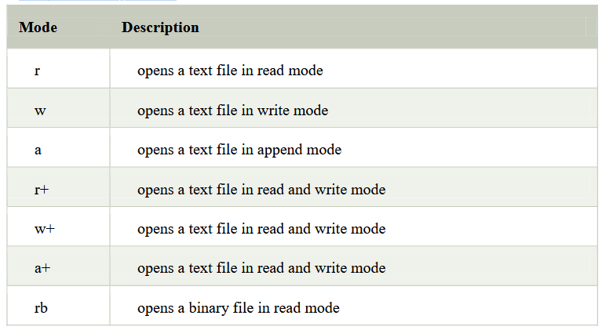
File Opening Modes

Slide 85
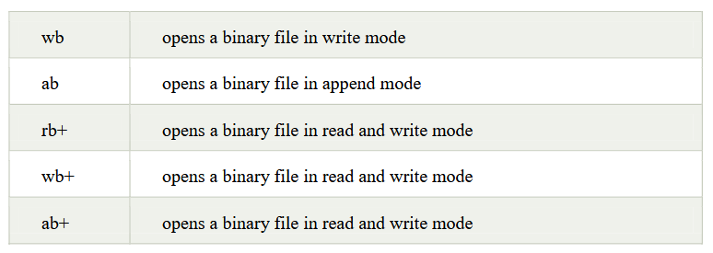
File Opening Modes

Slide 86
Difference between Append and Write Mode
Write (w) mode and Append (a) mode, while opening a file are almost the same. Both are used to write in a file. In both the modes, new file is created if it doesn't exists already.

Slide 87
Difference between Append and Write Mode
The only difference they have is, when you open a file in the write mode, the file is reset, resulting in deletion of any data already present in the file.
While in append mode this will not happen. Append mode is used to append or add data to the existing data of file(if any).

Slide 88
Difference between Append and Write Mode
Hence, when you open a file in Append(a) mode, the cursor is positioned at the end of the present data in the file.

Slide 89
Formatted File I/O Functions
Syntax of fprintf is
fprintf (fp, “control string”, list);
Example: fprintf(fp1, “%s %d”, name, age);
Syntax of fscanf is,
fscanf(fp, “control string”, list);
Example: fscanf(fp, “%s %d”, name, & age);

Slide 90
Formatted File I/O Functions
Note:
fscanf is used to read list of items from a file
fprintf is used to write a list of items to a file.
Note:
EOF – End of file (when EOF encountered the reading / writing should be terminated)

Slide 91
Formatted File I/O Functions
Example:
#include <stdio.h>
main(){
FILE *fp;
fp = fopen("file.txt", "w");//opening file
fprintf(fp, "Hello file by fprintf...\n");//writing data into file
fclose(fp);//closing file
}

Slide 92
Example 1. Write a program to open a file using fopen().
#include<stdio.h> void
main()
{
fopen()
file *fp;
fp=fopen(“student.DAT”, “r”);
if(fp==NULL)
{
printf(“The file could not be open”);
exit(0);
}

Slide 93
Example 2: Write to a text file using fprintf()
#include <stdio.h>
int main()
{
int num;
FILE *fptr;
fptr = fopen("C:\\program.txt","w");
if(fptr == NULL)
{
printf("Error!");
exit(1);
}
printf("Enter num: ");
scanf("%d",&num);
fprintf(fptr,"%d",num);
fclose(fptr);
return 0;
}

Slide 94
Example 3: Read from a text file using fscanf()
#include <stdio.h>
int main()
{
int num;
FILE *fptr;
if ((fptr = fopen("C:\\program.txt","r")) == NULL)
{
printf("Error! opening file"); // Program exits if the file pointer returns NULL.
exit(1);
}
fscanf(fptr,"%d", &num);
printf("Value of n=%d", num);
fclose(fptr);
return 0;
}

Slide 95
Example 4
Write a C program to read name and marks of n number of students from user and store them in a file. If the file previously exits, add the information of n students.

Slide 96
Example 4
#include <stdio.h>
int main()
{
char name[50];
int marks, i,n;
printf(“Enter number of students”);
scanf(“%d”, &n);
FILE *fptr;
fptr=(fopen(“C:\\student.txt”,”a”));
if (fptr==NULL)
{
printf("Error!");
exit(1);
}

Slide 97
Example 4
for(i=0;i<n;++i)
{
printf("For student%d\nEnter name: ",i+1);
scanf("%s",name);
printf(“Enter marks”);
scanf(“%d”, &marks);
fprintf(fptr, “\nName: %s\nMarks=%d\n”, name, marks);
}
fclose(fptr);
return 0;
}

Slide 98
Example 5
Write a program to read data from file and close using fclose function.
#include <stdio.h>
int main()
{
int n
FILE *fptr;
if ((fptr=fopen("C:\\program.txt","r"))==NULL)
{
printf("Error! opening file");
exit(1); // Program exits if file pointer returns NULL.
}

Slide 99
Example 5
fscanf(fptr,"%d",&n);
printf("Value of n=%d",n);
fclose(fptr);
return 0;
}

Slide 100
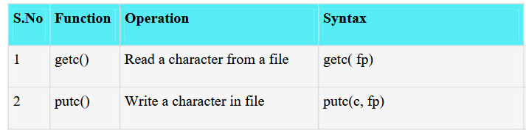
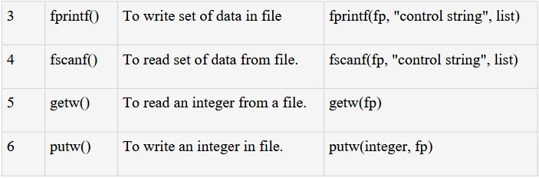
Input/Output Operation on files
To perform Input/Output Operation on files we need below functions.

Slide 101
Input/Output Operation on files
fputc() function
The fputc() function is used to write a single character into file.
putc ( ):-Putting a character in to the file. It works with only character data type. One character at a time can write into a file.
Ex: char ch =‘a’;
putc (ch, fp);

Slide 102
Input/Output Operation on files
Example:
#include <stdio.h>
main()
{
FILE *fp;
fp = fopen("file1.txt", "w");//opening file
fputc('a',fp);//writing single character into file
fclose(fp);//closing file
}
Output:
file1.txt
a

Slide 103
Input/Output Operation on files
fgetc() function
The fgetc() function returns/read a single character from the file. It gets a character from the stream. It returns EOF at the end of file.
getc ( ): getting a character from the file, or reading the file information character by character at a time, upto the end of the file by using this function.
Ex: char ch;
ch = getc (fp);

Slide 104
Input/Output Operation on files
Example:
#include<stdio.h>
#include<conio.h>
void main(){
FILE *fp;
char c;
clrscr();
fp=fopen("myfile.txt","r");
while((c=fgetc(fp))!=EOF)
{
printf("%c",c);
}
fclose(fp);
getch();
}
myfile.txt
this is simple text message

Slide 105
Input/Output Operation on files
fputs()
The fputs() function writes a line of characters into file

Slide 106
Input/Output Operation on files
Example:
#include<stdio.h>
#include<conio.h>
void main()
{
FILE *fp;
clrscr();
fp=fopen("myfile2.txt","w");
fputs("hello c programming",fp);
fclose(fp);
getch();
}
myfile2.txt
hello c programming

Slide 107
Input/Output Operation on files
fgets()
The fgets() function reads a line of characters from file.

Slide 108
Input/Output Operation on files
Example:
#include<stdio.h>
#include<conio.h>
void main()
{
FILE *fp;
char text[300];
clrscr();
fp=fopen("myfile2.txt","r");
printf("%s",fgets(text,200,fp));
fclose(fp);
getch();
}
Output:
hello c programming

Slide 109
Example 6
Write a C program to write all the members of an array of strucures to a file using fwrite(). Read the array from the file and display on the screen.

Slide 110
Example 6
#include<stdio.h>
struct s
{
char name[50];
int height;
};
int main()
{
struct s a[5], b[5];
FILE *fptr;
int I;
fptr=fopen(“file.txt”, “wb”);

Slide 111
Example 6
for(i=0; i<5; ++i)
{
fflush(stdin);
printf("Enter name: ") ;
gets(a[i].name);
printf("Enter height: ");
scanf("%d",&a[i].height);
}

Slide 112
Example 6
fwrite(a,sizeof(a),1,fptr);
fclose(fptr);
fptr=fopen("file.txt","rb");
fread(b,sizeof(b),1,fptr);
for(i=0;i<5;++i)
{
printf("Name:%s\nHeight:%d",b[i].name,b[i].height);
}
fclose(fptr);
}

Slide 113
Example 6
fwrite(a,sizeof(a),1,fptr);
fclose(fptr);
fptr=fopen("file.txt","rb");
fread(b,sizeof(b),1,fptr);
for(i=0;i<5;++i)
{
printf("Name:%s\nHeight:%d",b[i].name,b[i].height);
}
fclose(fptr);
}

Slide 114
Thank you….

